Slide 1

My Name Is Eric And I Play Thayne

Slide 2

My Name Is Kelsy And I Play Kirin

Slide 3

My Name Is Spencer And I Play Issac

Slide 4

My Name Is Alex And I Play Chuck “The Midnight” Hondooo

Slide 5
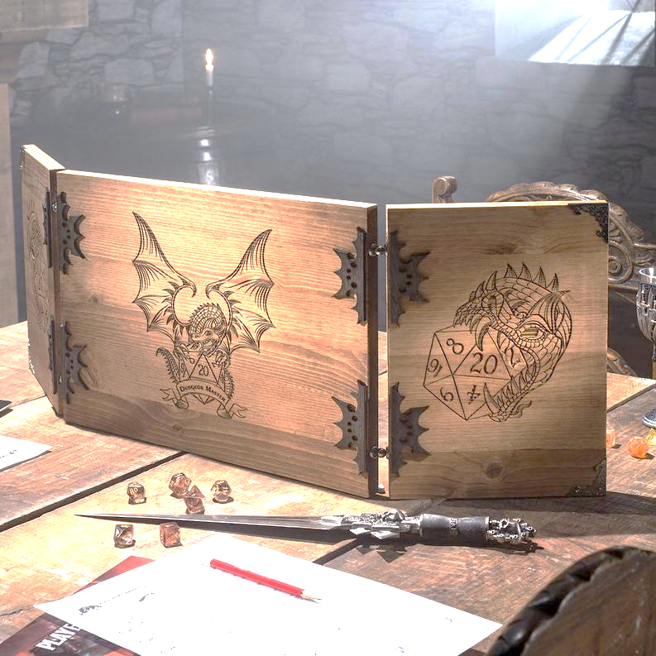
Last But Not Least – Joshua

Slide 6

Hoowee
Damn Girl

Slide 7
Oh My

Slide 8
Can we end this conversation

Slide 9
I do what’s familiar and I stab him

Slide 10
Hhhhaaa…
Shit.

Slide 11
Well son of a bitch

Slide 12
Son of a dick

Slide 13
You bastard

